Slide 1

Image from bayleafdigital
Customer Lifetime Value Prediction

Slide 2





Objective and Applications
Objective:
Create a model capable of predicting whether a customer will make at least one purchase in the next 12 months (churn) and the estimated gtv_acbr (LTV).
Understand our Client
Why does this customer have a low probability of buying from us again?
Customer Retention
Customer has LTV predicted 0,
can we do some action?
Segmentation
We can segment, based on LTV, and offer personalization to each group.
Budget Optimization
Direct marketing investments to
customers more assertively.

Slide 3
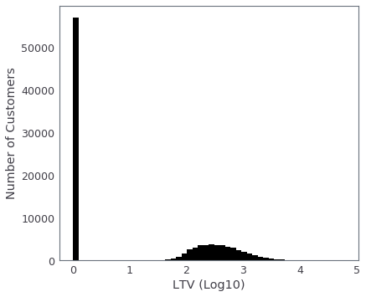

Challenge: Repurchase
≅ 40% return to buy within 12 months after the last purchase
* The percentage may vary according to conditions.
So, LTV distribution around R$ 0

Slide 4

Models

Slide 5











Model Overview
Customer Features
Models
Outputs
Will Buy? 0 or 1
Probability to Buy 0-1
Model 1: Will buy?
model 2 receives
outputs from model 1
Purchases History
Demographics
LTV = R$ XYZ
Engagement and
Navigation
Model 2: How much?
prediction for the next 12 months
calculated up to date d-1 of inference

Slide 6

*Note that the probability of not buying is inverse to the probability of buying.
Probabilities as Score
In general, above 50% probability we say the customer will buy. And the greater the probability, the more certainty we have in the prediction.
Thermometer
probability to buy
0.10
0.20
0.30
0.40
0.50
0.60
0.70
0.80
0.90
Customers close to 50% probability are the customers that the model has the most difficulty in telling whether the customer will buy or not.
Customers close to 10% have a very low probability of buying and are unlikely to buy in the next 12 months.
Customers close to 90% are customers that the model is quite sure the customer will buy. They are generally "top customers" and the model will make fewer mistakes.

Slide 7
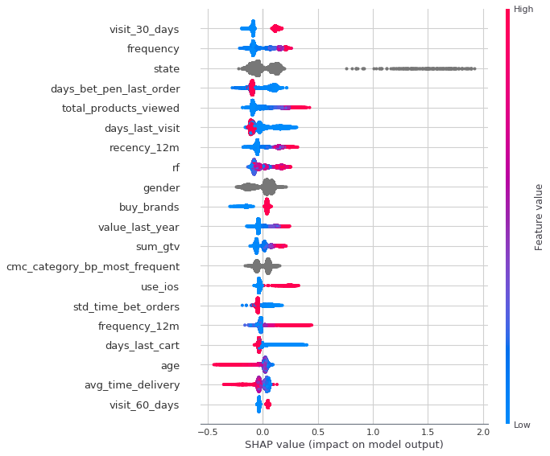
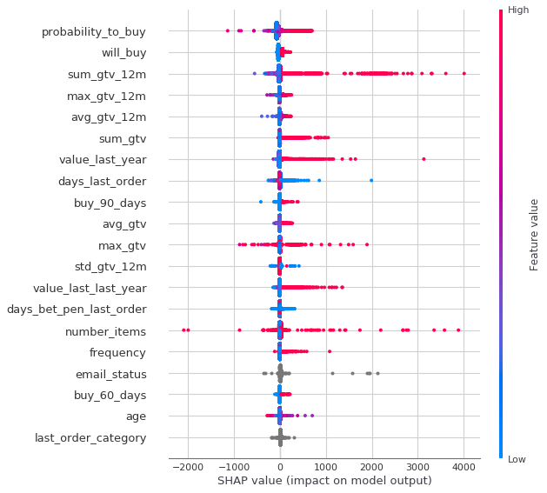
Feature Importance
*The higher up, the more the variable is important.
The 20 most important variables (Will Buy?)
The 20 most important variables (How Much?)

Slide 8
* variables in "-" are them that decrease the buy
probability and the inverse happens with "+".
Example (Will Buy?)
Will Buy (Real) = True
Will Buy (Real) = True
-
+
-
+
frequency = 1
buy_marketplace = True
sum_gtv = 294.89
value_last_year = 0
frequency_12m = 1
last_visit = 0
products_viewed = 114
visist_last_30_days = True
days_last_cart = 7
last_order = 7
state = MT
gtv_last_year = 0
buy_marketplace = True
avg_time_delivery = 15
newsletter = unsubscribed
sum_gtv = 2944,39
days_last_cart = 5
frequency_12m = 4
visit_last_30_day = True
product_viewed = 82
Prob(Will Buy) = 0,52
Prob(Will Buy) = 0,95

Slide 9
* variables in "-" are them that decrease the LTV and the inverse happens with "+".
Example (How Much?)
LTV Real = R$ 0,00
LTV Real = R$ 1.449,24
-
+
-
+
prob_buy = 0,16
sum_gtv_12m = 129,99
gtv_last_year = 0
buy_30_days = buy_180_days = 0
products_viewed = 3
no + features among the 10 most important
use_msite = True
avg_gtv = 174,49
...
prob_buy = 0,98
sum_gtv_12m = 2.179
total_visits = 149
max_gtv_12m = 539,79
frequency_12m = 11
LTV Pred = R$ 37,84
LTV Pred = 2.079,39

Slide 10
Curiosities
After searching our database, we found that the customer continued to shop with us, but with a new account.
LTV Real = R$ 0,00
-
+
last_order = 148
gtv_last_year = 0
sum_gtv_12m = 4.347
sum_gtv = 19.690
prob_buy = 0,82
frequency = 46
frequency_12m = 5
number_items = 130
LTV Pred = R$ 2.139,72

Slide 11

Experiments

Slide 12







Experiment (Simulation)
Simulating a Test on 20/05/20
As if we were on that day, and we had run a prediction for 1 year.
Will Buy? 0 or 1
Probability to Buy 0-1
LTV = R$ XYZ
100.000 Customers
Random active clients
from Dafiti Brazil
Customers Features
Variables of each customer
until 19/05/2020
Outputs
Predictions for each customer from
20/05/2020 to 20/05/2021

Slide 13


Experiments (Will Buy?)
Confidence Rate Experiments
Probability Thermometer
0.10
0.20
0.30
0.40
0.50
0.60
0.70
0.80
0.90
Probability*
N. Examples
Accuracy
Precision(1)
50%
100.000
68%
65%
70%
42.133
79%
78%
Accuracy
Percentage of examples classified correctly, whether buying or non-buying examples.
80%
17.921
85%
85%
90%
11.735
88%
92%
Precision
Percentage of examples where the model said the customer was going to buy, and actually, he did.
*Probability refers to the confidence threshold that we will accept at the base.
e.g. probability=0.8, only considers customers with an 80% or greater probability of buying or not buying.

Slide 14

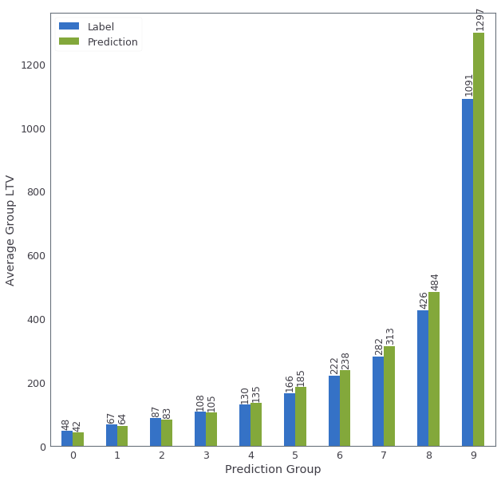
Experiments (How Much?)
Sum LTV (Forecast)
Real = R$ 26.308.149
Pred = R$ 29.514.519 (+10,86%)
Spearman’s
Correlation = 0.45
Similar to the state of the art [1] , [2]
In this group were the 10.000 customers with the highest LTV predicted. We expect a high LTV, but there may be isolated cases of low LTV.
Groups based on predicted LTV (Percentiles)
Group 9
AVG LTV Real = 1.297
AVG LTV Pred = 1.091
Group 0
AVG LTV Real = 48,00
AVG LTV Pred = 42,00
LTV 1.800
LTV 1.500
LTV 0
LTV 2.200
....
LTV 0
....
LTV 1.000
LTV 50
LTV 0
LTV 30
In this group were the 10.000 customers with the lowest LTV predicted. We expect a low LTV, but there may be isolated cases of high LTV.

Slide 15
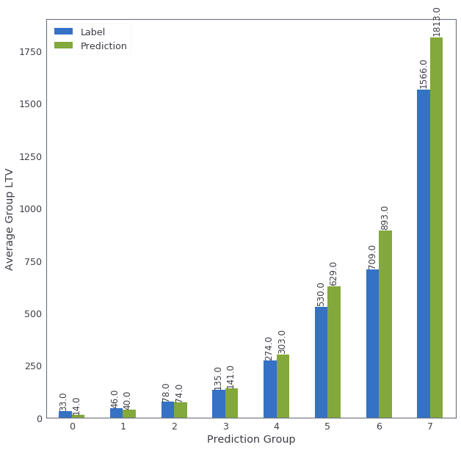
This means that group 0 has people with predicted LTV between R$0 and R$20. When calculating the average LTV of this group, we obtain an average of expected LTV = R$14 and R$33 of actual LTV average.
Experiments (How Much?)
Groups based on predicted LTV (Manual Buckets)
Group | Min LTV | Max LTV
0 | 0 | 20
1 | 20 | 50
2 | 50 | 100
3 | 100 | 200
4 | 200 | 500
5 | 500 | 800
6 | 800 | 1000
7 | 1000 | 10000
8 | 10000 | -

Slide 16
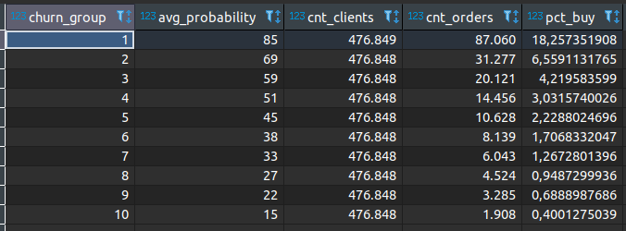
Monitoring Live Results: Churn Model (1 year)
In monitoring we divided active customers (+-4.7M) into 10 equal-sized groups based on their probability of purchase in 1 year/365 days. That is, group 1 is the 10% customers with the highest purchase probability and group 10, the 10% customers with the lowest purchase probability.
In this case, we are following the customers with the prediction of 19/05/2021 and how they are until today (updated 23/07/2021). In general the statistic is kept. That is, the greater the group's purchase probability, the higher the actual repurchase rate.
We can note that the group that the model gave the highest purchase probability is the group that has bought the most so far, that is, there have already been 87,060 purchases, which represents 18% of group 1, which have an average probability of 85%.
With group 10, the group with the lowest probability (average 15%), only 1,908 purchases were made, in a universe of 476,848 customers, which represents 0.4%.

Slide 17
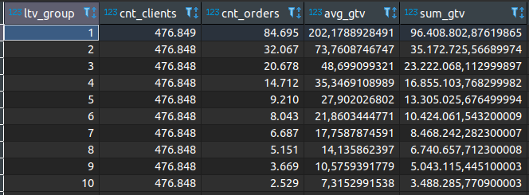
Monitoring Live Results: LTV Model (1 year)
In monitoring we divided active customers (+-4.7M) into 10 equal-sized groups based on their predicted LTV. That is, group 1 is the 10% customers with the highest LTV predicted and group 10, the 10% customers with the lowest LTV predicted.
In this case, we are following the customers with the prediction of 19/05/2021 and how they are until today (updated 23/07/2021). In general the statistic is kept. That is, the greater the group's LTV predicted, the higher the actual LTV.
The group with customers with the highest expected LTV has, so far, an average ticket of R$202 and a total amount of R$96m.
The group with customers with the lowest expected LTV has, so far, an average ticket of R$7 and a total amount of R$3M.

Slide 18

Implementation and Usage

Slide 19






Implementation
Deployment Architecture
Redshift Schedule
Train Data
Lambda Invoke
Start Step Functions
New config.json
Inference Data
All on AWS;
Run every 5th day of the month;
Active clients;
Keep historical records;
Step Function Execution
Choice
Train + Inference Path
Inference Path
Predictions in Redshift
New Training Job
New Model
Batch Transform
Predictions
1
2
1
2
3
4
Train Data
Docker
Inference Data

Slide 20
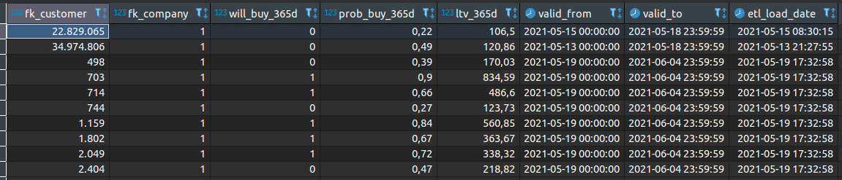
Model Predictions on Redshift - Example
Query to check your expected LTV
(active customers only - have made at least 1 valid purchase in the last year)
SELECT
*
FROM
curated_data.lifetime_value_estimation
WHERE
fk_customer = <your_pk_customer>
Run every 5th day of the month;
Active clients from “DAFITI BRAZIL”;
Data available on
curated_data.lifetime_value_estimation.
fk_customer from business_layer.dim_customer;
Keep historical records.

Slide 21
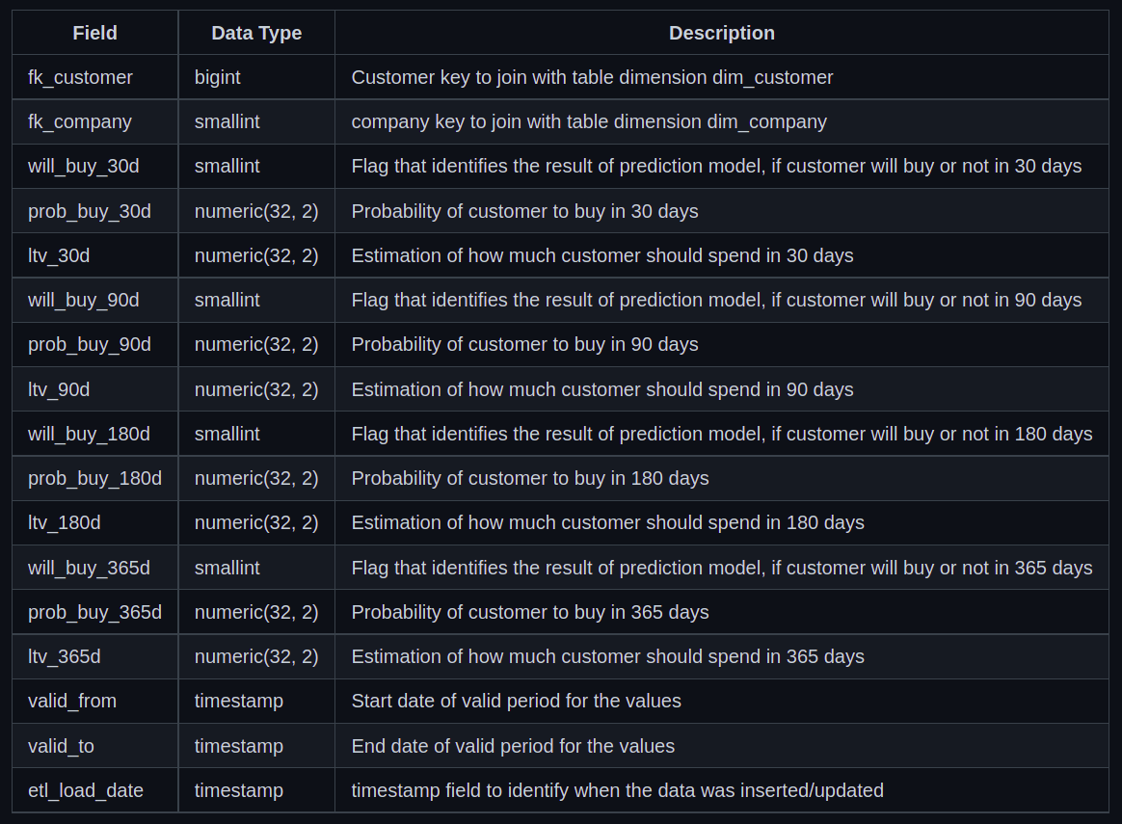
Model Predictions on Redshift - Variables

Slide 22

Conclusions and Next Steps

Slide 23

Conclusions
Model 2: How Much?
It can be better applied to a grouped statistic or even a score.
Models aren't perfect
But they can definitely help in many applications.
Model 1: Will Buy?
Based on the probabilities we can be much more accurate in our predictions.

Slide 24


Working On
RFM
RFM-Based
Segmentation Algorithm
More Time Periods
LTV/Churn for next
1-3-6-24 months?

Slide 25


Next Releases
Shap Values
Top variables (actionables) that most influenced the predictions.
eg. customer x has a low probability of purchase, because he had a long delivery delay in his first purchase.
LATAM
Expand to Kanui, Tricae
and Dafiti AR/CO/CL

Slide 26

Next Steps
Real Test

Slide 27
Documentation on Confluence
Features Documentation
Github Repository
ML Canvas
Results Sheet
Video Presentation
Attachments

Slide 28
[1] Chamberlain, Benjamin Paul, et al. "Customer lifetime value prediction using embeddings." Proceedings of the 23rd ACM SIGKDD International Conference on Knowledge Discovery and Data Mining. 2017.
[2] Vanderveld, Ali, et al. "An engagement-based customer lifetime value system for e-commerce." Proceedings of the 22nd ACM SIGKDD International Conference on Knowledge Discovery and Data Mining. 2016.
[3] Wang, Xiaojing, Tianqi Liu, and Jingang Miao. "A Deep Probabilistic Model for Customer Lifetime Value Prediction." arXiv preprint arXiv:1912.07753 (2019).
All icons from flaticon
References

Slide 29
Thank You!
Questions?
Email: willian.dihanster@dafiti.com.br or
research-and-development@dafiti.com.br

